Slide 1
Lesson 10:
The animal model

Slide 2
The limits of GLS
We have learnt how to run linear models with complex autocorrelation structures (GLS)
Unfortunately, the method has limits:
It assumes the response data is normally distributed
It cannot handle replication of individuals in species
So how can we deal with repetition and response data with non-normal distributions?

Slide 3
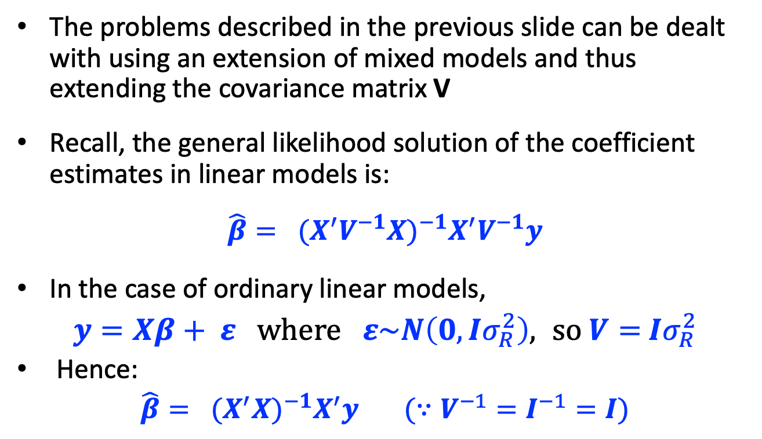
The animal model
The problems described in the previous slide can be dealt with using an extension of mixed models and thus extending the covariance matrix V
Recall, the general likelihood solution of the coefficient estimates in linear models is:
$$\hat{β}= {{(X}^{′}V^{−1}X)}^{−1}X^{′}V^{−1}y$$
In the case of ordinary linear models,
$y=Xβ+ ε where ε\sim N\left(0,Iσ_{R}^{2}\right), so V=$ $Iσ_{R}^{2}$
Hence:
$\hat{β}= {{(X}^{′}X)}^{−1}X^{′}y (∵V^{−1}=I^{−1}=I)$

Slide 4
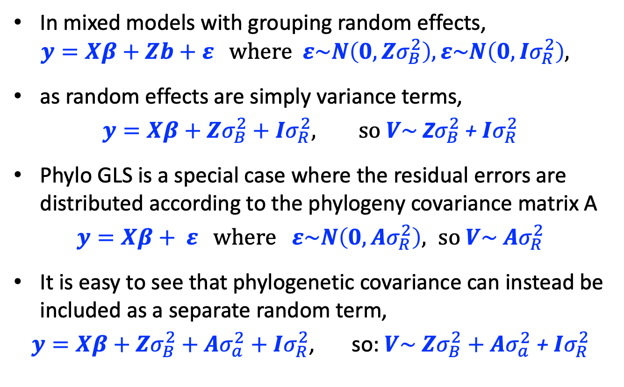
The animal model
In mixed models with grouping random effects,
$$y=Xβ+Zb+ε where ε\sim N\left(0,Zσ_{B}^{2}\right), ε\sim N\left(0,Iσ_{R}^{2}\right),$$
as random effects are simply variance terms,
$y=Xβ+Zσ_{B}^{2}+Iσ_{R}^{2}, so V\sim$ Z$σ_{B}^{2}$+ $Iσ_{R}^{2}$
Phylo GLS is a special case where the residual errors are distributed according to the phylogeny covariance matrix A
$y=Xβ+ ε where ε\sim N\left(0,Aσ_{R}^{2}\right), so V\sim$ $Aσ_{R}^{2}$
It is easy to see that phylogenetic covariance can instead be included as a separate random term,
$y=Xβ+Zσ_{B}^{2}+Aσ_{a}^{2}+Iσ_{R}^{2}$, so: $V\sim$ $Zσ_{B}^{2}+Aσ_{a}^{2}$ + $Iσ_{R}^{2}$

Slide 5
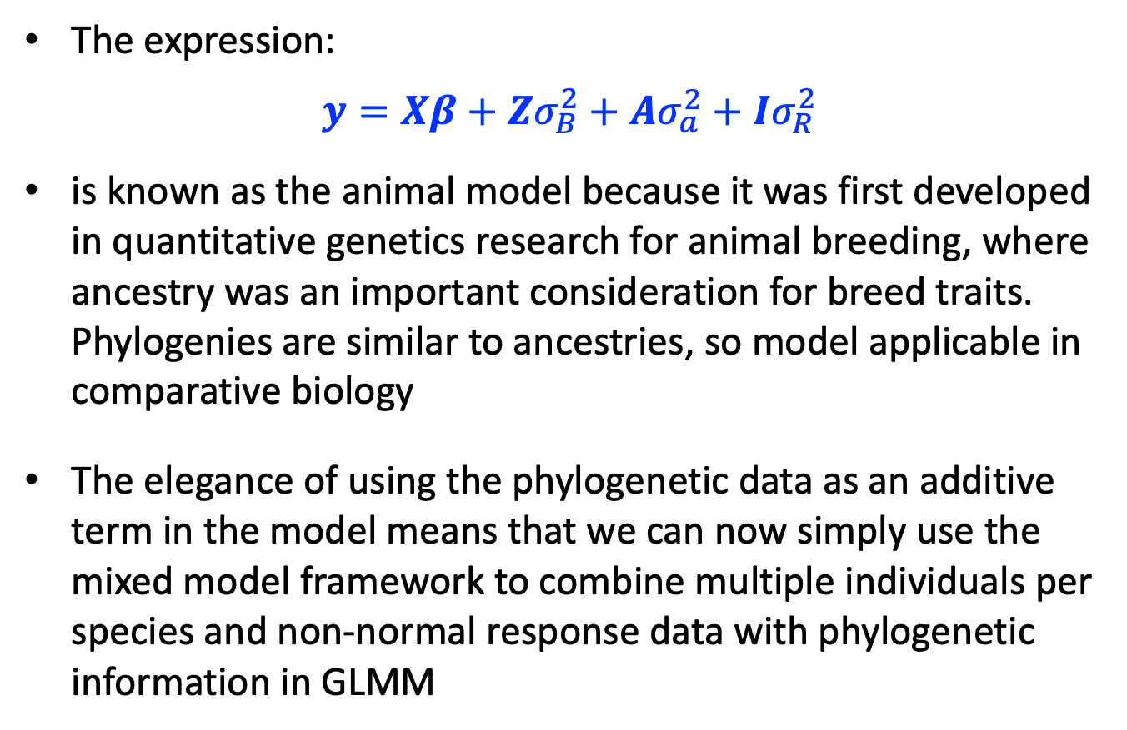
The animal model
The expression:
$$y=Xβ+Zσ_{B}^{2}+Aσ_{a}^{2}+Iσ_{R}^{2}$$
is known as the animal model because it was first developed in quantitative genetics research for animal breeding, where ancestry was an important consideration for breed traits. Phylogenies are similar to ancestries, so model applicable in comparative biology
The elegance of using the phylogenetic data as an additive term in the model means that we can now simply use the mixed model framework to combine multiple individuals per species and non-normal response data with phylogenetic information in GLMM

Slide 6
A crisis of code
The only package I am aware of that runs the animal model using the frequentist statistical framework is asreml. Unfortunately we have to pay to use this software!!!
By contrast there are several packages for handling the animal model using the Bayesian statistical framework. Therefore we will run the animal model using Bayesian packages in R. I am aware of two packages that do this well: MCMCglmm and brms. We will use brms here.
The linear function in brms has been set up to mimic glmer() so is relatively easy to use

Slide 7
Frequentism vs Bayesianism
Before going any further, its important that we say something very briefly about the main differences between frequentist versus bayesian approaches
It is necessary to understand this to understand the basics of the code

Slide 8
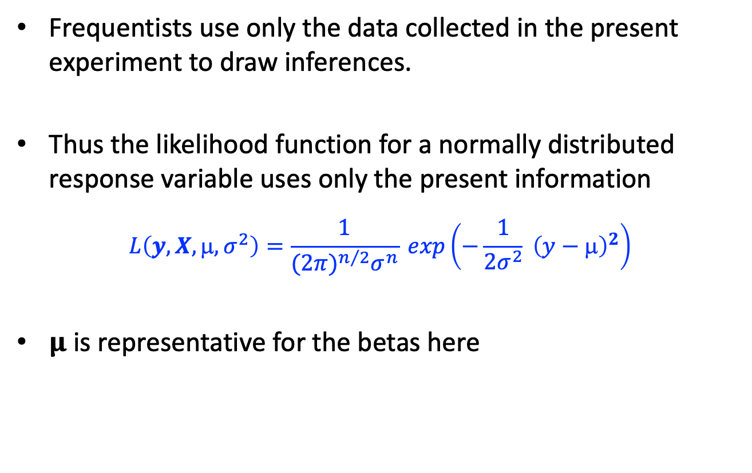
Frequentism
Frequentists use only the data collected in the present experiment to draw inferences.
Thus the likelihood function for a normally distributed response variable uses only the present information
$$L\left(y,X,μ,σ^{2}\right)=\frac{1}{{(2π)}^{n/2}σ^{n}} exp\left(−\frac{1}{2σ^{2}} {\left(y−μ\right)}^{2}\right)$$
𝛍 is representative for the betas here

Slide 9
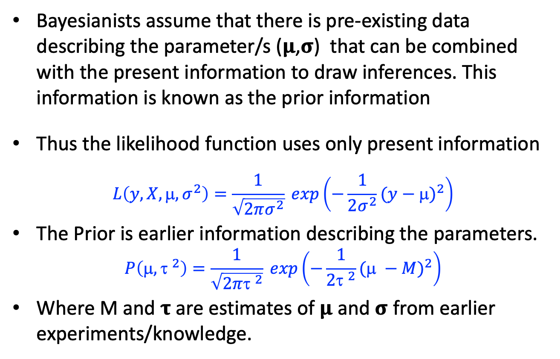
Bayesianism
Bayesianists assume that there is pre-existing data describing the parameter/s (𝛍,𝛔) that can be combined with the present information to draw inferences. This information is known as the prior information
Thus the likelihood function uses only present information
$$L\left(y,X,μ,σ^{2}\right)=\frac{1}{\sqrt{2πσ^{2}}} exp\left(−\frac{1}{2σ^{2}}{(y−μ)}^{2}\right)$$
The Prior is earlier information describing the parameters.
$$P\left(μ,{τ }^{2}\right)=\frac{1}{\sqrt{2π{τ }^{2}}} exp\left(−\frac{1}{2{τ }^{2}}{(μ −M)}^{2}\right)$$
Where M and 𝛕 are estimates of 𝛍 and 𝛔 from earlier experiments/knowledge.

Slide 10
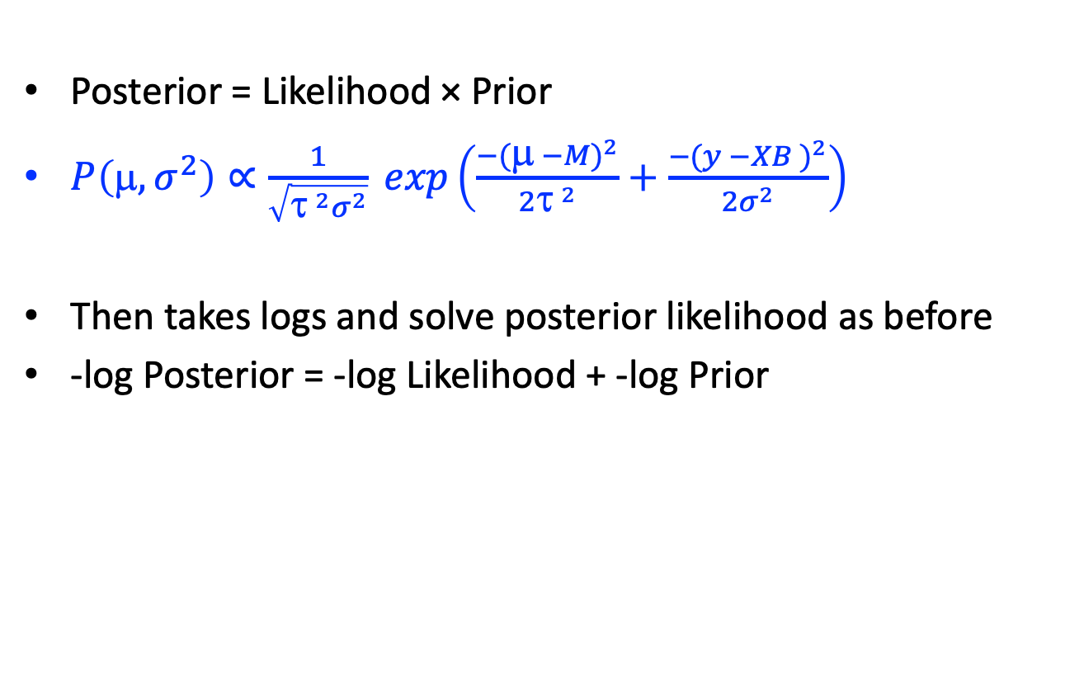
Bayesianism
Posterior = Likelihood × Prior
$P\left(μ,σ^{2}\right)∝\frac{1}{\sqrt{{τ }^{2}σ^{2}}} exp\left(\frac{{−(μ −M)}^{2}}{2{τ }^{2}}+\frac{{−(y −XB )}^{2}}{2σ^{2}}\right)$
Then takes logs and solve posterior likelihood as before
-log Posterior = -log Likelihood + -log Prior

Slide 11
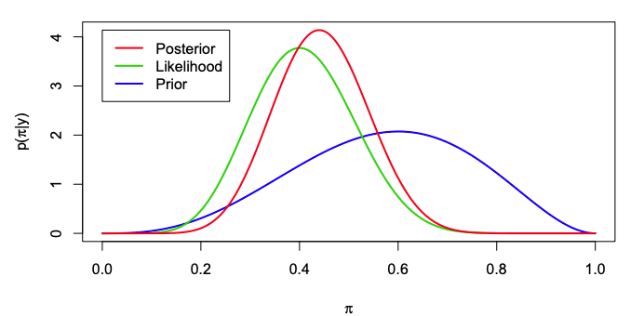
Frequentism vs Bayesianism

Slide 12
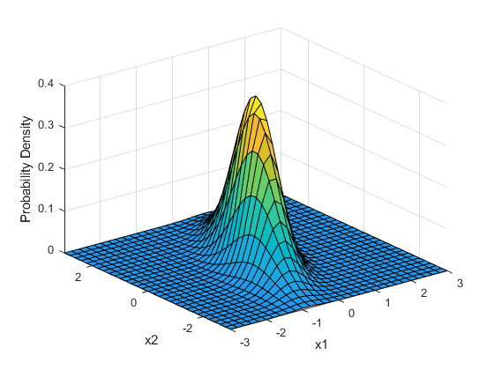
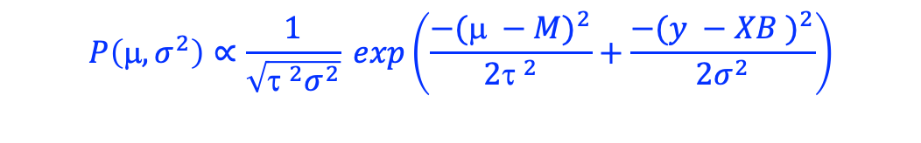
Parameter drawing in Bayesian models
$$P\left(μ,σ^{2}\right)∝\frac{1}{\sqrt{{τ }^{2}σ^{2}}} exp\left(\frac{{−(μ −M)}^{2}}{2{τ }^{2}}+\frac{{−(y −XB )}^{2}}{2σ^{2}}\right)$$
Posterior likelihood function
B2
B1
Sample the predictor space and draw the distributions

Slide 13
The brm() glmm function
mod <- brm(Dlog~x1+(1|phy)+(1|Sp), cov_ranef = list(phy = phylo_cor),data = bark2, family = gaussian(), sample_prior = TRUE,
iter = 20000,warmup = 10000, chains = 4, cores = 4, thin = 10, save_all_pars = TRUE,seed=T, control=list(adapt_delta=0.99))
Priors can be “informative” or “non-informative:”
These will be discussed in the next lecture
For now we will accept the defaults in the brm() function.

Slide 14
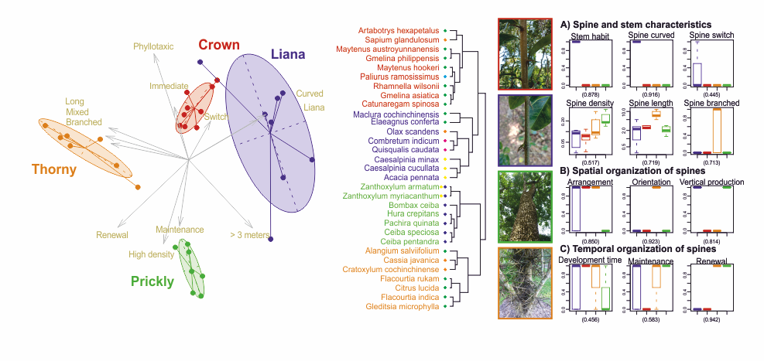
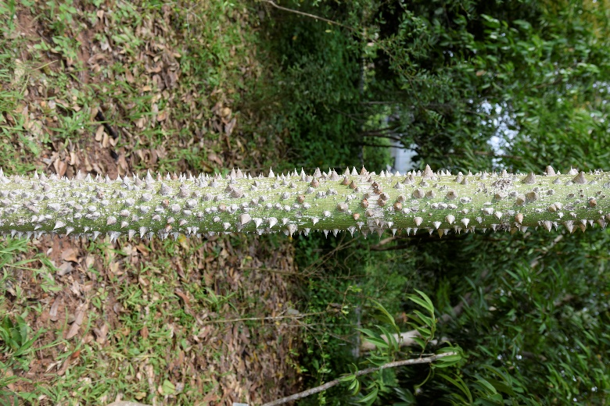
Spiny trunk data
Different species with spiny trunks cluster out.
Do they have different nutritional value and defence efficiency?

Slide 15
Code 10.1
Linear model with species repeats

